Slide 1
LECTURE 7 - HEAT TRANSFER WITH
CHANGE OF PHASE
Explain the freezing process of a biomaterial over a temperature range
Explain the process of freezing in a cellular tissue
Understand changes in thermal and physical properties of biomaterials during freezing (already seen in ABE 30300)
Calculate the time to freeze or thaw a biomaterial

Slide 2
KEYWORDS
Heat of Fusion
Supercooling
Nucleation
Crystal Growth
Freezing point depression
Semi-permeable membrane
Cryopreservation
"Musty" texture
Vapor pressure
Boiling
Boiling point elevation
Evapotranspiration

Slide 3
Energetic changes in pure water
2257 kJ/kg
Enthalpy
333-335 kJ/kg
0
100
Temperature ºC

Slide 4
Property Changes during Freezing
Specific Volume
Thermal Conductivity
Specific Heat
Dielectric Loss

Slide 5

Freezing of Solutions and Biomaterials
m: Molality mol/kg solvent

Slide 6
Freezing Point Depression
Molality of the solution
Solvent | K_{f} (K/mol/kg)
Water | 1.86
Hexane | 5.12
Acetic Acid | 3.90

Slide 7
The Freezing Process
Cellular Material
Semipermeable
Membranes

Slide 8
Freezing of Cellular Material
Extracellular water freezes
Osmotic pressure moves water from inside the cell to outside
Water freezes in extracellular space

Slide 9
Quick Freezing also cause fracture

Slide 10
Temperature Profile and Freezing Time
Initially all material is at freezing temperature T_{m} but unfrozen
All material freezes at one freezing point
Thermal conductivity of the frozen layer is constant
T_{m}
x

Slide 11
Temperature Profile and Freezing Time

Slide 12
Temperature Profile and Freezing Time
For a slab of half-thickness L

Slide 13
Temperature Profile and Freezing Time
Heat

Slide 14
Temperature Profile and Freezing Time
Considering resistance due to convection

Slide 15
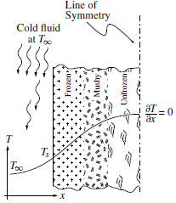
Freezing of Biomaterials

Slide 16
Frozen in a Cylinder
unfrozen Layer
Frozen Layer
r
Frozen Layer
T_{m}
dr
R
r
T_{s}
L
R
Unfrozen Layer

Slide 17
Frozen in a Cylinder
unfrozen Layer
Frozen Layer
r
Frozen Layer
T_{m}
dr
R
r
L
R
Unfrozen Layer

Slide 18
Frozen in a Sphere
R
r
dr

Slide 19
SUMMARY
Slab
Cylinder
Sphere

Slide 20
Evaporation

Slide 21
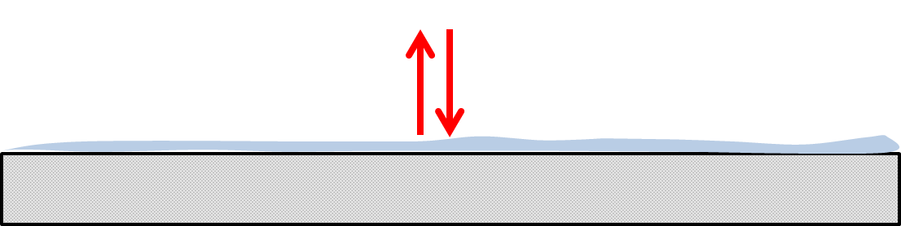
Evaporation from wet surfaces

Slide 22
Plant Systems (plant and soil systems)
Evapotranspiration = Evaporation + Transpiration
Evaporation in animal systems (Evaporative cooling)
Evaporation Inside a Solid Matrix
Vapor diffuses
Evaporation of Solutions

Slide 23
Evaporation of Solutions

Slide 24
Boiling Point Rise
Solvent | K_{b} (K/mol/kg)
Water | 0.51
Ethanol | 1.22
Hexane | 2.53
CHCl₃ | 3.63
Acetic Acid | 2.93
CCl₄ | 5.03

